Slide 1



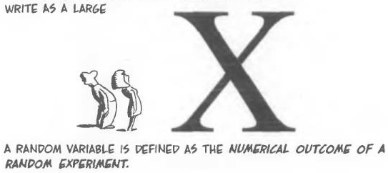

Random Variables
Chapter 4 Part 1
Dr. Abolfazl Saghafi
Assistant Professor of Statistics & Data Science
Data Science Program Director
Notes:
Shit is about to get real!

Slide 2
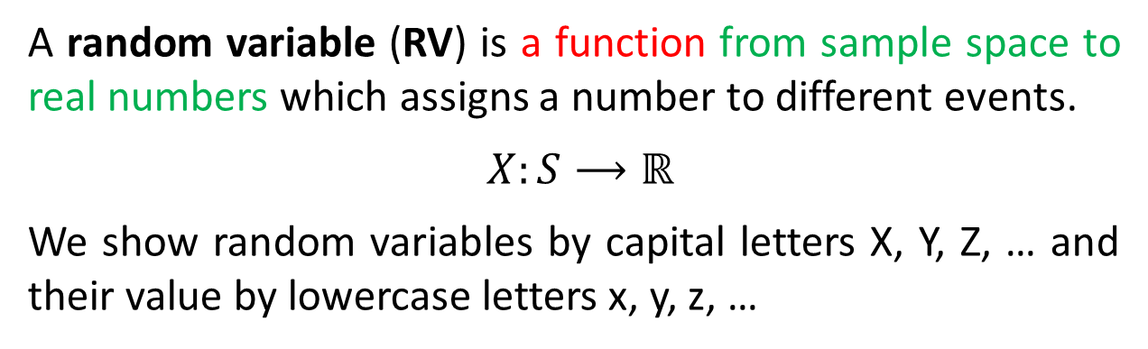
Random Variables
By using RV’s we are quantifying outcomes of an experiment.
A random variable (RV) is a function from sample space to real numbers which assigns a number to different events.
$$X:S⟶ℝ$$
We show random variables by capital letters X, Y, Z, … and their value by lowercase letters x, y, z, …
X
S
Rx
S
HH
2
HH
HT
1
Example 1. In the experiment of throwing a fair coin twice
S = {HH, HT, TH, TT}
HT
TH
TH
0
TT
If we define random variable X as the number of heads, then X maps S to {0, 1, 2}.
TT
X assigns a value of 2 to HH, …
We can represent events using the newly defined RV, e.g.
A = {HT, TH, HH} =
{X ≥ 1}
B = {TT, HH} =
{X=0}U{X=2}
Rx={0, 1, 2}
Notes:
Rx is called the support or range of X.

Slide 3
Example 2. Experiment of throwing a fair coin until a head appears.
Example 3. Experiment of the measuring the lifetime of a car.
If we define random variable Y as the number of trials until first head appears, then Y maps S to {1, 2, 3, …}
If we define random variable X as the lifetime of a car, then X maps S to [ 0, ∞ )
S=[ 0, ∞ )
S = { H, TH, TTH, TTTH, …}
X
Rx = [ 0, ∞ )
Ry={ 1 , 2 , 3 , 4 , …}
The following events can be represented by X as
The following events can be represented by Y as
A = {0} =
B = (4, ∞) =
C = [1, 100] =
{X = 0}
A = { TTH, TTTH, TTTTH, . . . } =
{ Y ≥ 3 }
{ X > 4 }
{ 1 ≤ X ≤ 100 }
B = { TH, TTH, . . . , TTTTTTH } =
{ 2 ≤ Y ≤ 7 }

Slide 4
Random Variables Types
Depending on the support of a random variable we have two different types of random variables:
Discrete RV
where the support of random variable is a finite or countable.
Continuous RV
where the support of random variable is countless, usually an interval.
Ex1. Rx={0, 1, 2}
Ex2. Ry={1, 2, 3, …}
Ex3. Rx=[0, ∞)
We will now focus on discrete RVs
Will be discussed in the next chapter

Slide 5
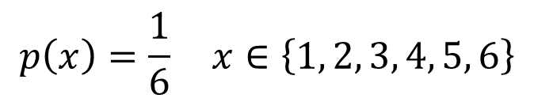
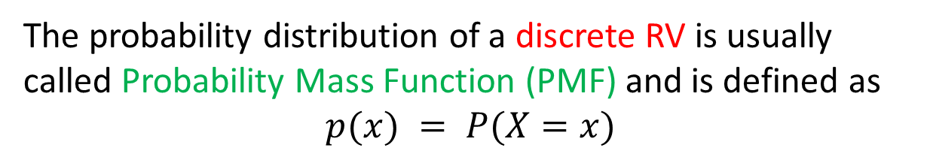
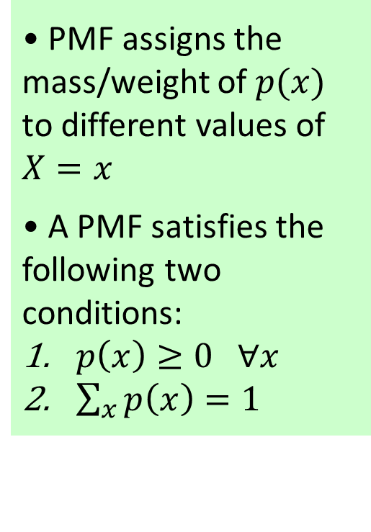
Probability Distribution
• PMF assigns the mass/weight of $p(x)$ to different values of $X=x$
• A PMF satisfies the following two conditions:
$p\left(x\right)≥0 ∀x$
$\sum_{x}{p\left(x\right)}=1$
A probability distribution is an assignment of probabilities to different values of a random variable.
The probability distribution of a discrete RV is usually called Probability Mass Function (PMF) and is defined as
$$p(x) = P(X=x)$$
There are three different ways in which we can express a PMF:
Read as “for all”
$$p\left(x\right)=\frac{1}{6} x∈\left\{1, 2, 3, 4, 5, 6\right\}$$
1. Mathematical Formula
2. Probability Table
3. Bar Chart
Notes:
What I have here as the mathematical formula is just an example, but see how the probabilities in the table is represented by that formula
If you probabilities follow a binomial distribution, the formula will be binomial PMF which is discussed in the next session

Slide 6
Example
A fair coin is tossed twice, identify the PMF of the RV X defined as “the number of heads”.
Step1. Identify the Sample Space
S = {TT, TH, HT, HH}
Sum
Step2. Identify the support of the RV and create a probability table
Rx = {0 , 1 , 2}
Step3. Fill out the table by
computing corresponding probabilities
p(0) = P(X=0) = P({TT}) =
p(1) = P(X=1) = P({TH,HT}) =
p(2) = P(X=2) = P({HH}) =
Notes:
We go through 3 steps to get to the PMF

Slide 7
prob
Example
4/16
A fair die with four sides numbered from 1 to 4 is tossed twice, identify the probability distribution of the RV
X: the sum of the two observed values
1/16
2
3
4
5
6
7
8
Step1. Sample Space
Step2. Rx and
probability table
Rx = {2, 3, 4, 5, 6, 7, 8}
Step3.
Sum
the die is fair so we have
16 equally likely simple events
each with probability 1/16
Notes:
The number of possible outcomes for this experiment is 4*4=16 which is computed using product rule.

Slide 8




Question
Q1. Two coins are randomly selected from a bag with seven coins: 4 -1cents, 2 -5cents, and 1- 25cents
Identify the probability distribution of
X: sum of the value of the two coins
1
Q2. A spinner is divided into four parts, numbered from 1 to 4. When this spinner is spun, the arrow randomly points to one of the numbers and you win its prize. Find PMF of X: the prize
2
4
3
Notes:
Q2. S = {Ted, Carl, Pikachu, Clap} Rx = {1 , 2 , 3, 4}
p(1)=1/8, p(2)=1/4, p(3)=1/4, p(4)=3/8
Q1. We learned about sample space of this experiment at the beginning of probability chapter, it is S ={(1,1),(1,5),(1,25),(5,1),(5,5),(5,25),(25,1),(25,5)} but since the number of coins is different, these simple events in the S are not equally likely. To create an equally likely S, we can construct the following table that considers different number of coins, NA represents Not Applicable since you can’t pick the same coin twice if its without replacement
1st\2nd 1 1 1 1 5 5 25
1 NA (1,1) (1,1) (1,1) (1,5) (1,5) (1,25)
1 (1,1) NA (1,1) (1,1) (1,5) (1,5) (1,25)
1 (1,1) (1,1) NA (1,1) (1,5) (1,5) (1,25)
1 (1,1) (1,1) (1,1) NA (1,5) (1,5) (1,25)
5 (5,1) (5,1) (5,1) (5,1) NA (5,5) (5,25)
5 (5,1) (5,1) (5,1) (5,1) (5,5) NA (5,25)
25 (25,1) (25,1) (25,1) (25,1) (25,5) (25,5) NA
Therefore, Rx={2, 6, 10, 26, 30} with probabilities
p(2)=12/42, p(6)=16/42, p(10)=2/42, p(26)=8/42, p(30)=4/42

Slide 9

Characteristics of a Probability Distribution
Notes:
Think of probability distribution as a theoretical formulation of a problem, in practice, when we actually do an experiment what we see is the frequency distribution, for example

Slide 10

Probability Distribution Vs Frequency Distribution
S = {TT, TH, HT, HH}
Rx = {0 , 1 , 2}
Consider example of tossing a fair coin twice and counting the number of heads. We know that
Sum
If someone tosses a fair coin twice for 1000 times and counts the number of heads, he/she could get the following frequency table
Sum
If the mad tosser continues tossing the coin the relative frequency distribution gets closer to the probability distribution
Notes:
In the example of tossing a fair coin twice and counting the number of heads, we saw that the probability distribution is like this table
If you compare the two tables you see that they are not exactly the same but the relative frequencies are pretty close to the computed probabilities, if you increase the number of experiments they get even closer
we expect that if we compute the central tendency and spread measures for the frequency table, we get a close approximation of the parameters

Slide 11

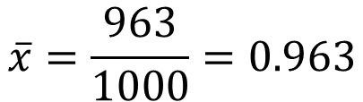
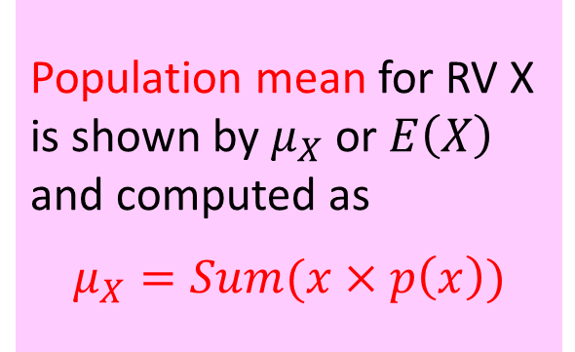

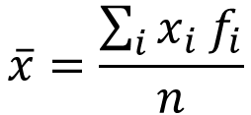
Population Mean Vs Sample Mean
Population mean for RV X is shown by $μ_{X}$ or $E\left(X\right)$ and computed as
$$μ_{X}=Sum(x×p\left(x\right))$$
When the frequency distribution converges to probability distribution, all its numerical characteristics converge too, including the mean, median, mode, variance, etc.
Sum
Sum
$$\overline{x}=\frac{963}{1000}=0.963$$
$$μ_{X}=1$$
$$\overline{x}=\frac{\sum_{i}{x_{i}{ f}_{i}}}{n}$$
Law of Large Numbers
Notes:
Population Mean is also known as Expected Value

Slide 12
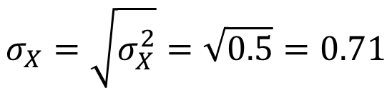
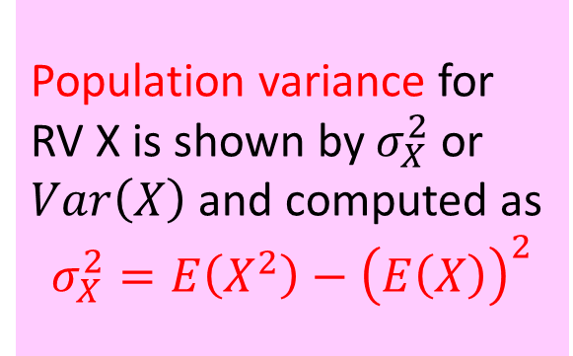

Population Variance Vs Sample Variance
Population variance for RV X is shown by $σ_{X}^{2}$or $Var\left(X\right)$ and computed as
$$σ_{X}^{2}=E\left(X^{2}\right)−{\left(E\left(X\right)\right)}^{2}$$
We learned how to compute sample variance and sample standard deviation in chapter 2. Population variance and standard deviation are computed using a PMF:
Sum
Sum
1.5
$$σ_{X}^{2}=1.5−{\left(1\right)}^{2}=0.5$$
$$σ_{X}=\sqrt{σ_{X}^{2}}=\sqrt{0.5}=0.71$$
Notes:
$$E\left(X^{2}\right)=Sum(x^{2}×p\left(x\right))$$

Slide 13
Example
Kevin is rolling a fair die. If a prime number occurs, he pays his girlfriend that number of dollars; if a nonprime number is observed, she pays him that number of dollars.
Find the expected value of RV X: win/loss in each game, and explain what it means. Compute the variance of X.
Notes:
1. S = {1, 2, 3, 4, 5, 6}
2. Rx = {1, -2 , -3, 4, -5, 6}={-5, -3, -2, 1, 4, 6}
3. x -5 -3 -2 1 4 6
p(x) 1/6 1/6 1/6 1/6 1/6 1/6
x*p(x) -5/6 -3/6 -2/6 1/6 4/6 6/6
4. Sum(x*p(x))=(-5/6)+(-3/6)+(-2/6)+(1/6)+(4/6)+(6/6)=1/6
It is expected that Kevin wins 1/6 of a dollar (16 cents) on average at each game

Slide 14
Answer
S = {1, 2, 3, 4, 5, 6}
X: the money Kev wins/loses in each game
Rx = {1, -2 , -3, 4, -5, 6}
Sum
= {-5, -3, -2, 1, 4, 6}
A value of 1/6 for the expected value means that on average Kevin wins 1/6th of a dolor (16cents) at each game.
Sum

Slide 15


Mean or Expected Value
The mean of a distribution is its pivot point which balances the distribution
prob
1/6
-5
-4
-3
-2
-1
0
1
2
3
4
5
6
μ=1/6
prob
4/8
prob
1/3
1/8
2
3
4
5
6
7
8
1
2
3
μ=5
μ=2
Notes:
The mean here is closer to Ralph since he’s heavier (duh!)

Slide 16
Examples
Ex1. The given table shows the probability distribution of RV X. Use the information to compute the expected value and variance of X.
Ex2. The probability distribution of a RV X is given below.
Determine the E(X) and explain its usefulness
Obtain the Var(X)
Compute the expected value and variance of Y where Y = 1 – 2 X
Sum
Notes:
Ex2.
x 4 8 12 16
p(x) 1/8 2/8 3/8 2/8
x.p(x) 4/8 16/8 36/8 32/8
Sum(x.p(x))=88/8=11 which the center of gravity for the distribution of X
x^2.p(x) 16/8 128/8 432/8 512/8
Sum(x^2.p(x))=1088/8=136
Var(X)=Sum(x^2.p(x))-(Sum(x.p(x)))^2= 136-(11)^2= 15
E(Y)=1-2E(X)=1-2*11=-21 Var(Y)=(-2)^2*Var(X)=4*136=544

Slide 17
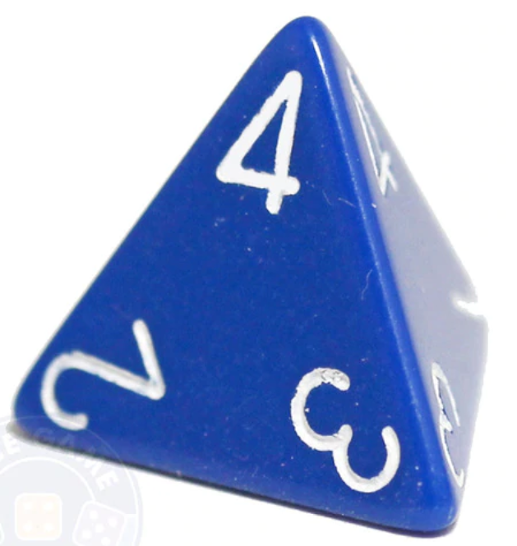

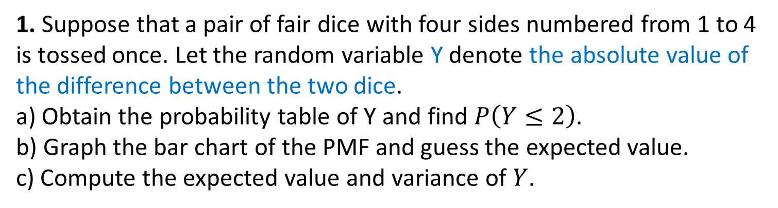
Practice Problems Part 1
1. Suppose that a pair of fair dice with four sides numbered from 1 to 4 is tossed once. Let the random variable Y denote the absolute value of the difference between the two dice.
a) Obtain the probability table of Y and find $P\left(Y≤2\right)$.
b) Graph the bar chart of the PMF and guess the expected value.
c) Compute the expected value and variance of $Y$.
2. The probability distribution of a RV X is given in the table.
a) Determine the E(X) and explain its usefulness.
b) Obtain the Var(X) and E(Xᶟ).
c) Compute the expected value and variance of random variable Y where Y = 1 – 2 X.
Notes:
Answers are provided in Ch4 Practice Problem Solutions

Slide 18

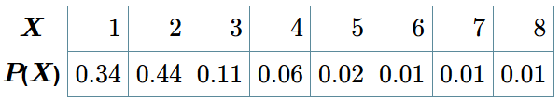
Practice Problems Part 1
3. In a particular week of September, chance of having zero, one, two and three rainy days are 0.2, 0.5, 0.2, and 0.1, respectively. What is the expected number of rainy days for that particular week?
4. The number of persons X, in a Singapore family chosen at random has the following probability distribution. What is the average family size?
5. The
Notes:
Answers are provided in Ch4 Practice Problem Solutions.

